Slide 1
Age of Industrial Revolution
Naturalist collected and classified around thousand of animals and plants.
New advanced methods of surgical operations were invented.
New scientific truths disapproved the previous erroneous concepts in science.
Therefore it was popularly called as age of Revolution in the development of science and technology.

Slide 2
Why did the Industrial Revolution being in England?
Availability of natural resources such as coal, iron and developed farmlands.
steam engine and textile machines
population growth
from cottage system to factory system

Slide 3
James Watt's Steam Engine
Scottish Inventor and Mechanical engineer
it was called the Watt Steam Engine in 1775
the Watt Steam Engine was not the first steam engine.
in 1679 Thomas Savery was the first person who invented the Steam engine for work in mines.
in 1712 Thomas Newcomen (1663-1729) invented the first steam engine.

Slide 4
It widely used to pump water out of coal mines.
he improved upon Newcomen Steam engine by using condenser, therefore it was known as the improved design of Newcomen engine.

Slide 5
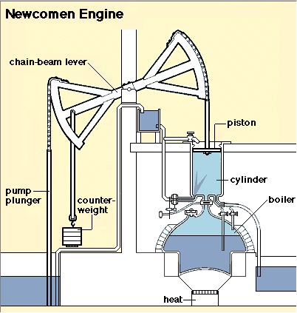
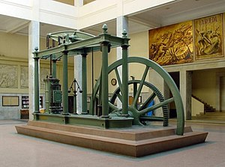
James Watt’s Steam Engine

Slide 6
Textile Industry
The word ‘calico’ is derived from ‘Calicut’ a weaving centre on west coast of India.
‘Calico’ the general term was used for all cotton cloths of all kinds import from the east.
Calico introduced in England by EEIC.
Lancashire in England famous centre of textiles
In Latin ‘textile’ means a ‘woven fabric’
18th Century had tremendous progress in textile industry

Slide 7
Outbreak of Industrial Revolution in England brought a radical change in the spinning and weaving technology.
Man-made textiles were replaced by machine-made products
Discovery of new trade and sea routes which promoted trade and commerce.

Slide 8
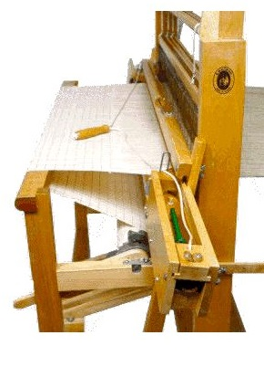
John Kay’s
Flying Shuttle (1733)
In 1733 John Kays (1704-64) invented flying shuttle.
It was the first great invention for increasing the productions of textiles.
John Kays basically clock maker.
It used for quick weaving to be produce faster and large quantity.

Slide 9
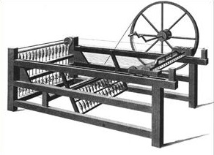
James Hargreave’s (1702-1778)
Spinning Jenny (1764)
he named after the berth of his daughter Jenny.
it used 8 spindles instead of 1. A single wheel on the spinning jenny controlled 8 spindles which create 8 threads.
later on, models had up to 120 spindles

Slide 10
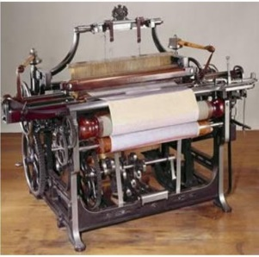
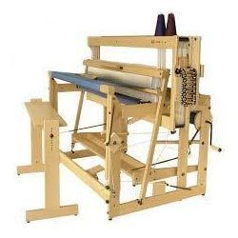
Edmund Cartwright
Power Loom (1785 )
For weaving as well as spinning.

Slide 11
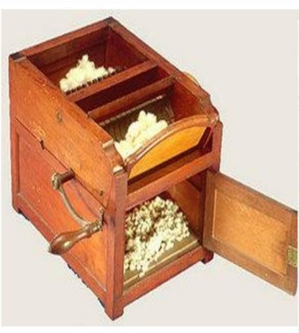
Eli Whitney's
Cotton Gin (1793)
Eli Whitney's Cotton Gin invented in 1793.
it separated cotton from seeds
it removed the seeds from the cotton quickly and efficiently.

